Slide 1

AMCAT Data Analysis
By :
Suresh Pendem
IN9240358

Slide 2
About me​
My name is Suresh Pendem.
I completed my B.Sc in Computer Science and currently focusing on Data Science.
Data science helps to create new ideas and technology, like smarter computers, robots that can do tasks automatically.
GitHub : https://github.com/SureshPendem-706
Linkedin : https://www.linkedin.com/in/sureshpendem/

Slide 3
Agenda
Introduction :
The dataset is released by AMCAT which is an organization will conduct test for the engineering students who seeking job.
The test results was shared with recruiters they will conduct the direct interview for students who performed well.
Objective :
Based on students performance on AMCAT test, engineering background find out salary, job titles, job locations, employment roles.

Slide 4
I Used these Libraries :
Data Cleaning Steps :
Pandas
Numpy
Seaborn
Matplotlib
Understand the data
Drop one column
Handling missing values
Handling Outliers
Check the Duplicates
Correcting the datatypes

Slide 5
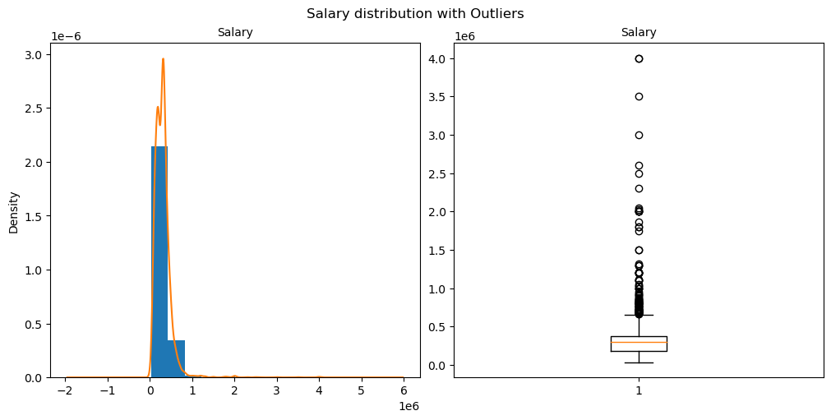
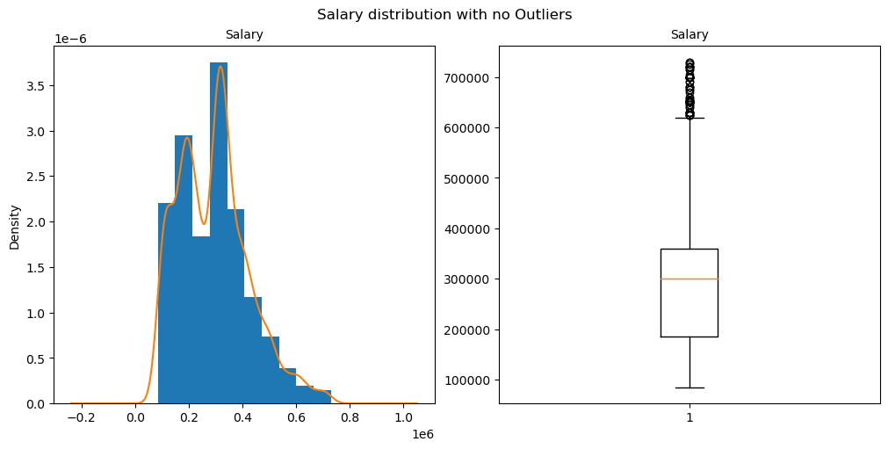
Handling Outliers in Target column : Salary
Before Outliers
After Outliers

Slide 6
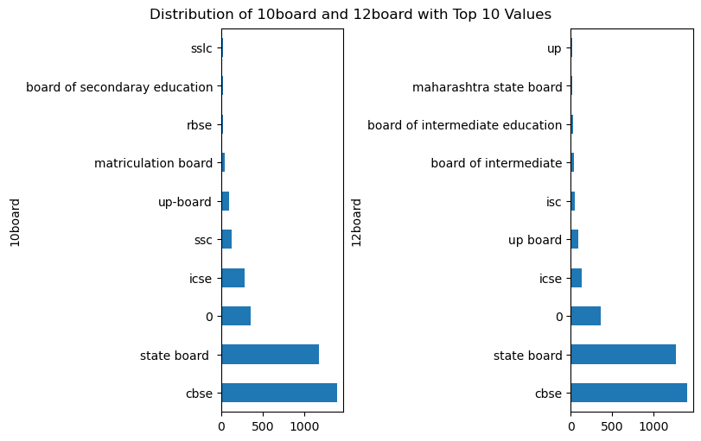
Univariate Analysis : Categorical ​
Most of students studied their 10th and intermediate in cbse .

Slide 7
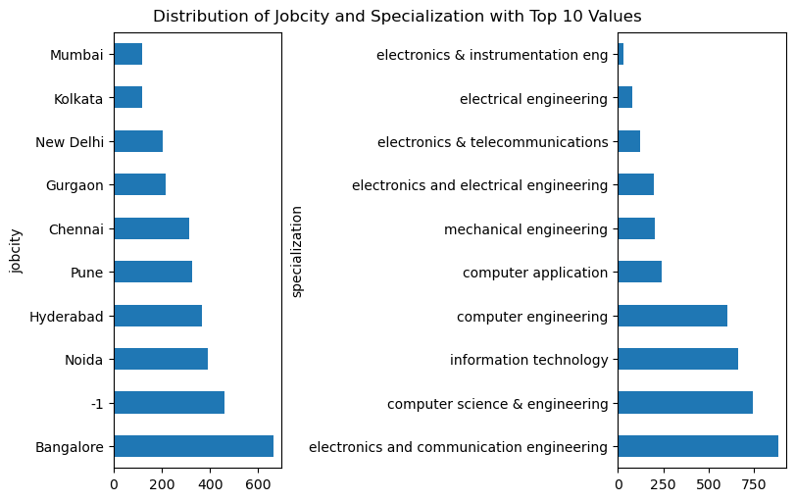
Univariate Analysis : Categorical
Job city : Most of the students got job in Bangalore.
Specialization : Most of the students completed their degree in electronic and communication engineering.

Slide 8
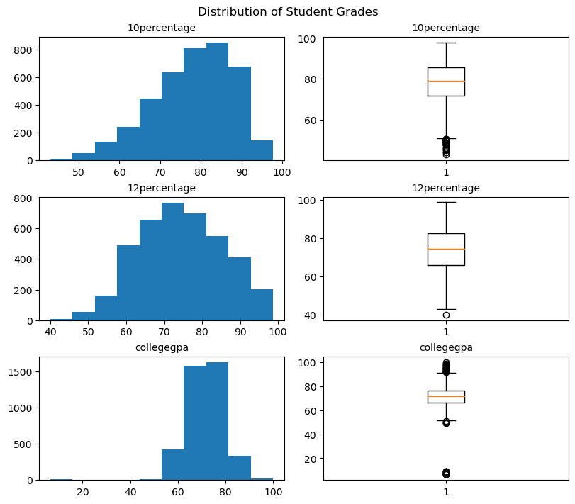
Univariate Analysis : Numerical
Most of students did well in 10th and 12th grades, with most scores between 70% and 90%. However, college GPAs show more variation, with some students doing much better or worse than others.

Slide 9
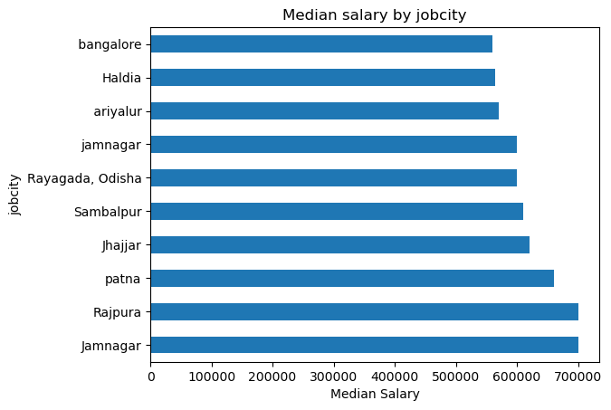
Bivariate Analysis : Numerical​ vs Categorical
Students who got job in Jamnagar and Rajpura are get same average salary and higher than other cities.

Slide 10
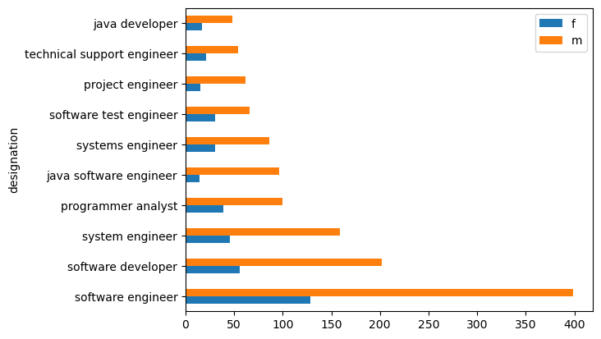
Bivariate Analysis : Categorical vs Categorical​
Males are higher than Females in any designation and software engineer have highest employees both male and female .

Slide 11
Conclusion : ​
Students who got job in Jamnagar and Rajpura are get same average salary and higher than other cities.
Males are higher than Females in any designation and software engineer have highest employees both male and female .
Most of students did well in 10th and 12th grades, with most scores between 70% and 90%. However, college GPAs show more variation, with some students doing much better or worse than others.
Job city : Most of the students got job in Bangalore.
Specialization : Most of the students completed their degree in electronic and communication engineering.
Most of students studied their 10th and intermediate in cbse .

Slide 12

THANK YOU

